Slide 1
Laser Material Processing
Lecture 10
Laser Micromachining

Slide 2
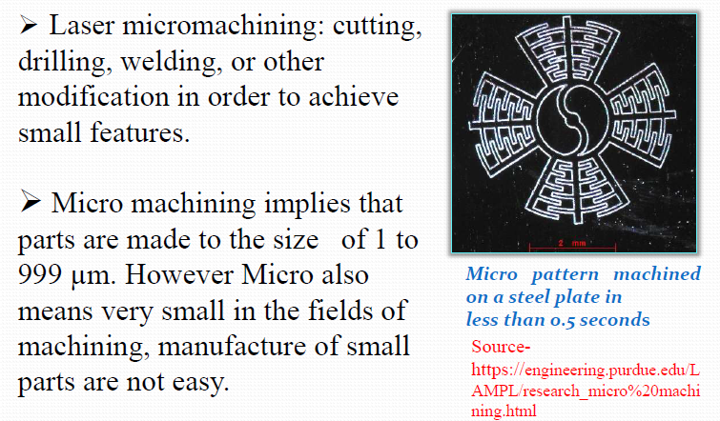
Laser Micromachining

Slide 3
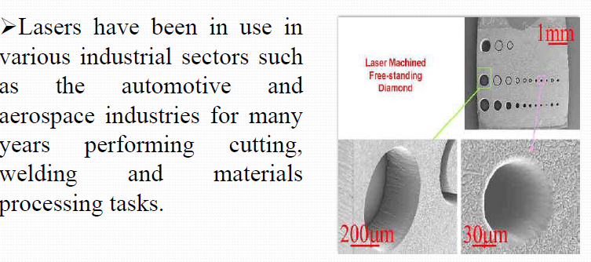
Laser Micromachining

Slide 4
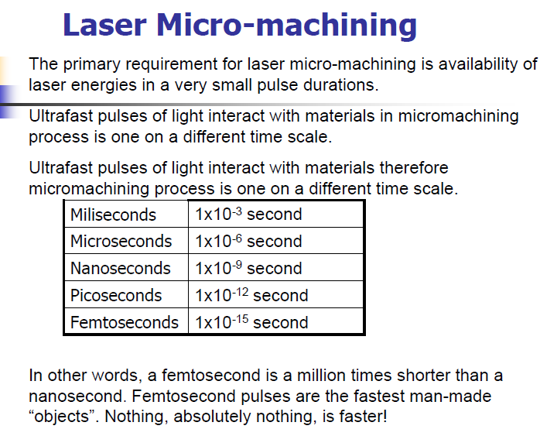

Slide 5
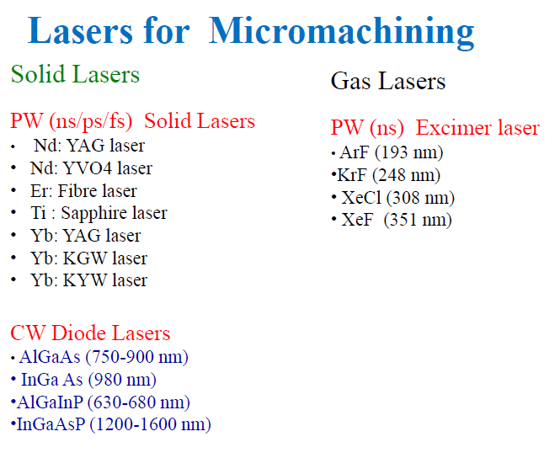
PW Pulse mod CW Continuous mode

Slide 6
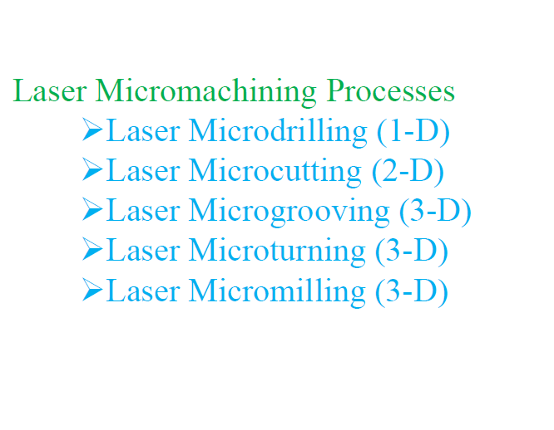
Laser Micromachining

Slide 7
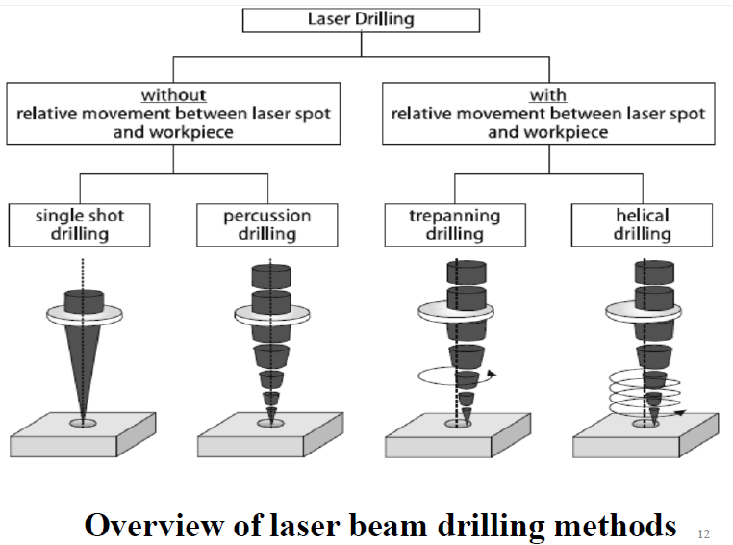
Laser Micrdrilling

Slide 8
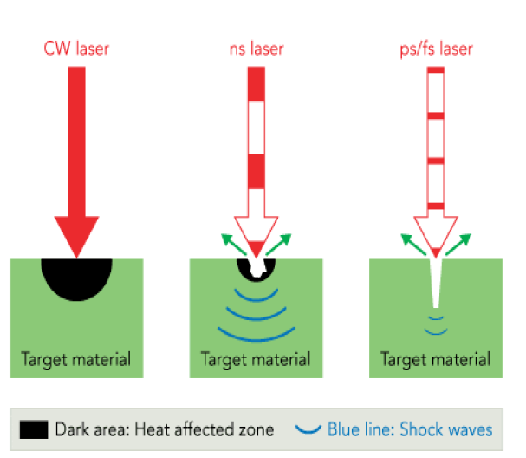
Laser Micrdrilling

Slide 9
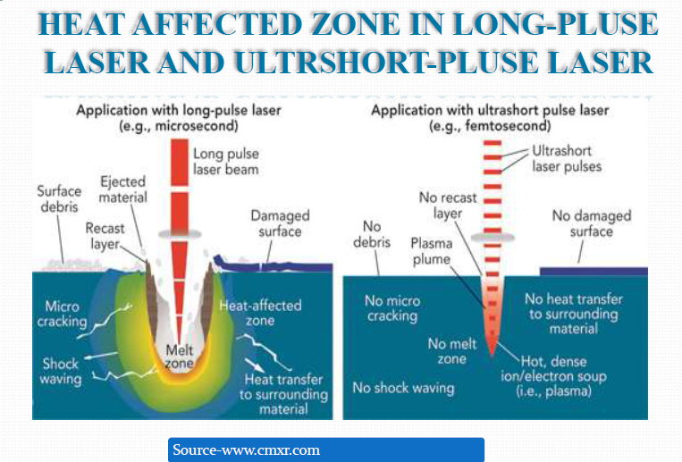
Laser Micrdrilling

Slide 10
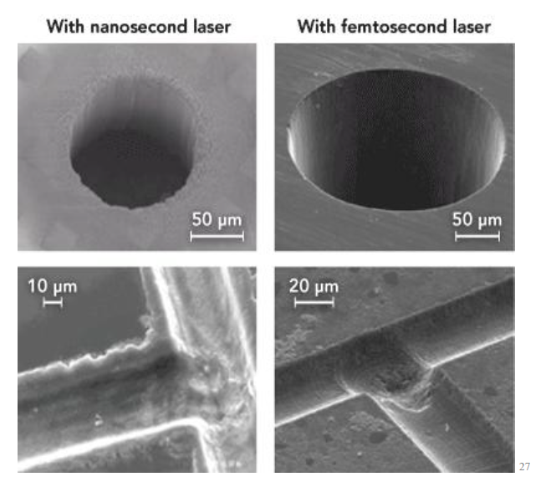
Laser Micrdrilling

Slide 11
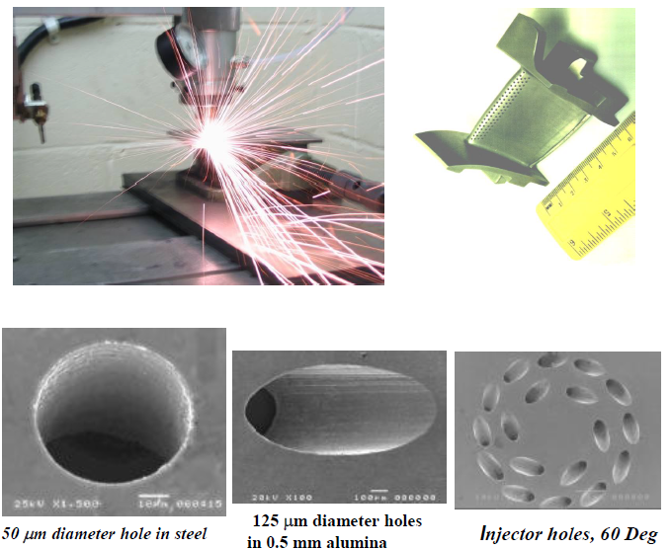

Slide 12
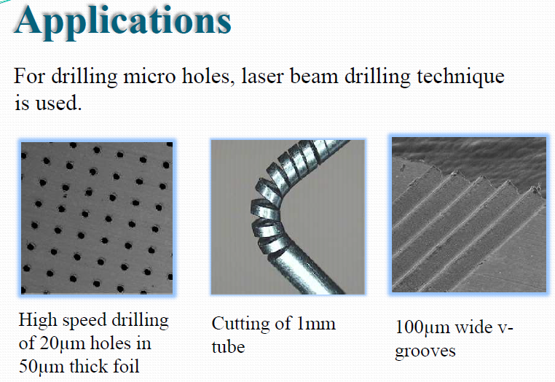
Laser Micrdrilling

Slide 13
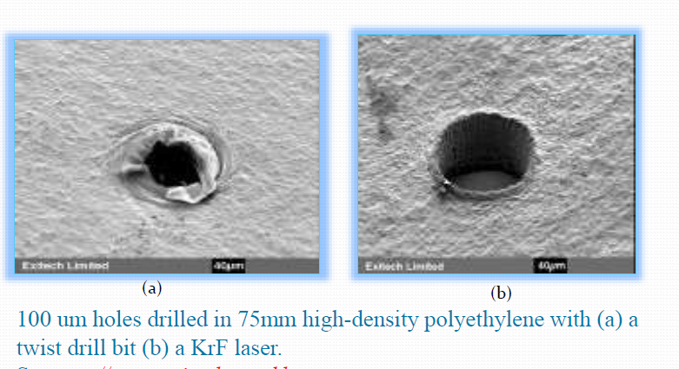
Laser Micrdrilling

Slide 14
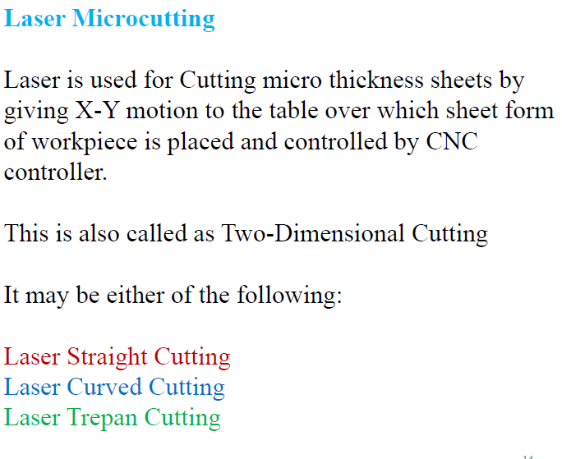

Slide 15
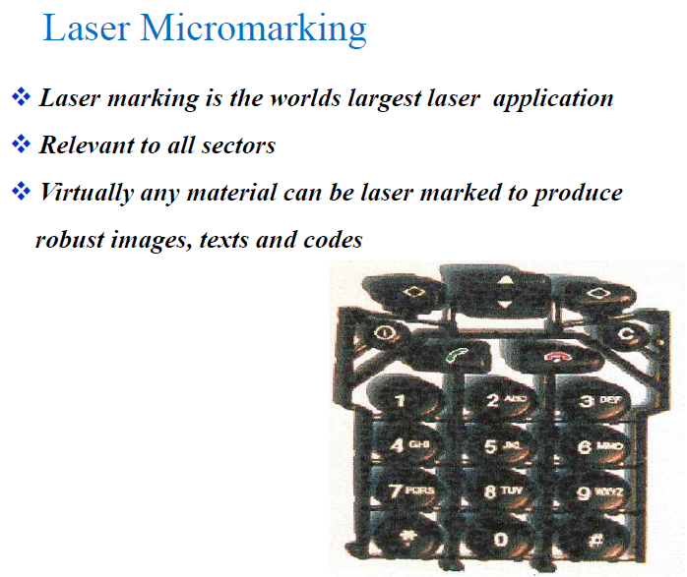

Slide 16
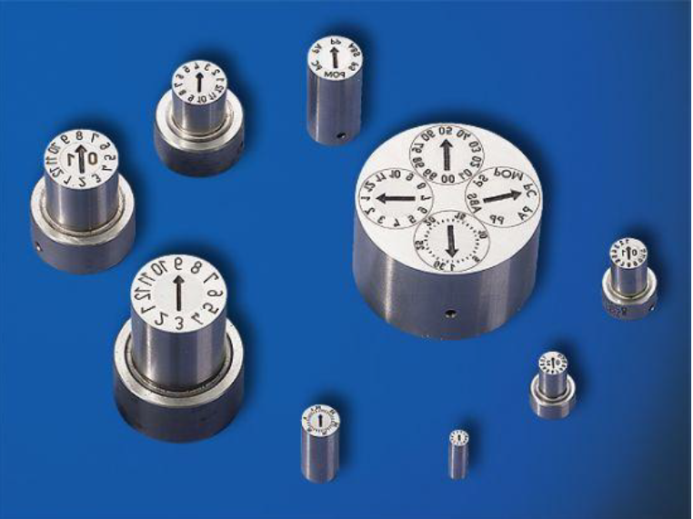

Slide 17
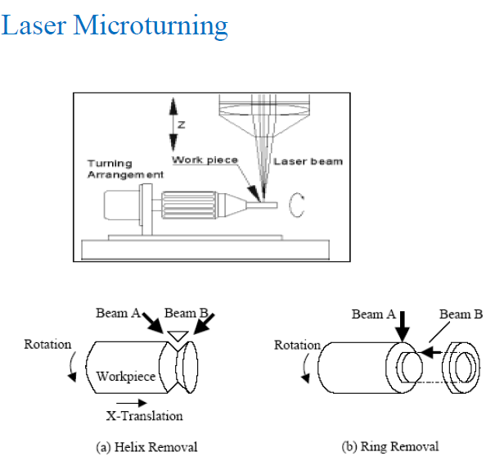

Slide 18
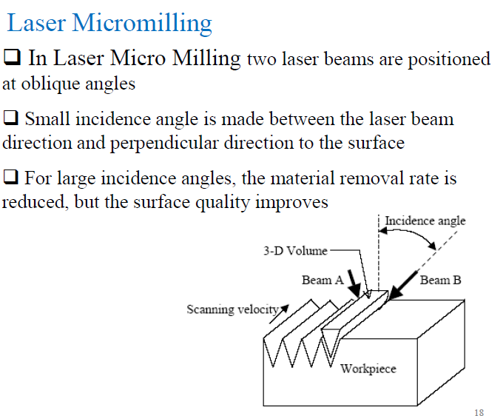

Slide 19
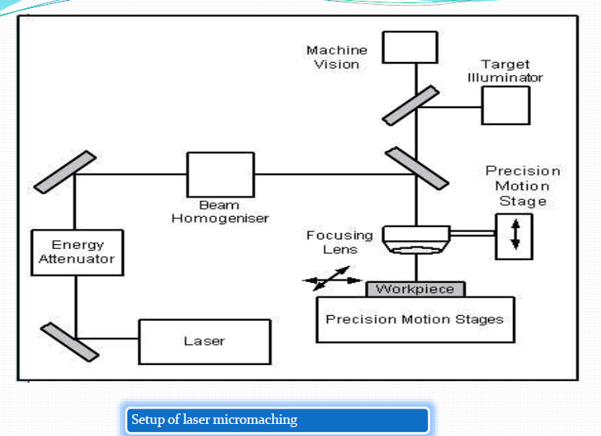

Slide 20

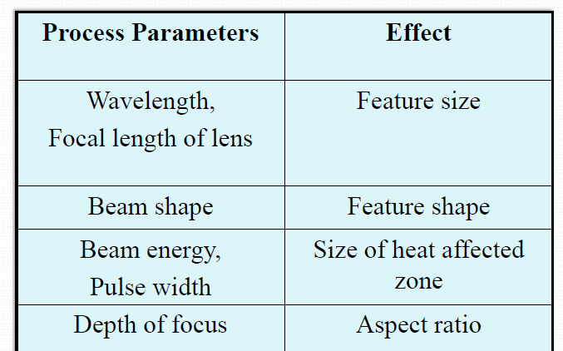
Laser Parameters Effects

Slide 21
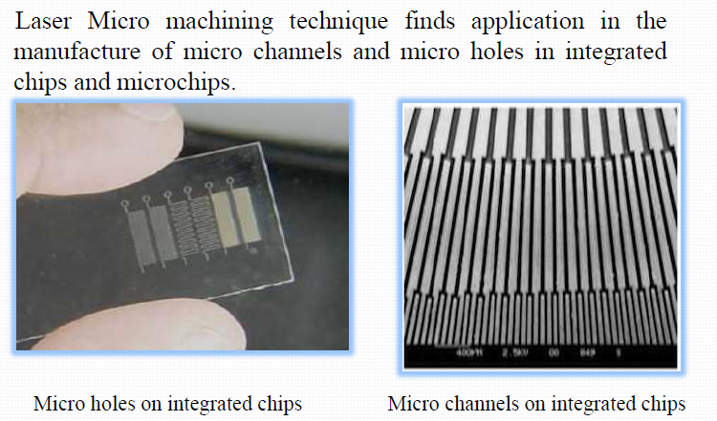
Laser Micromachining

Slide 22
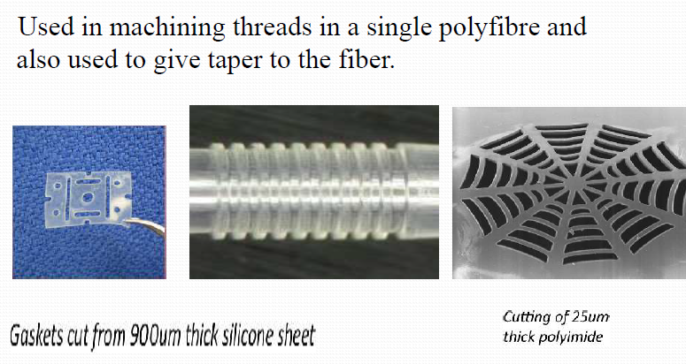
Laser Micromachining

Slide 23
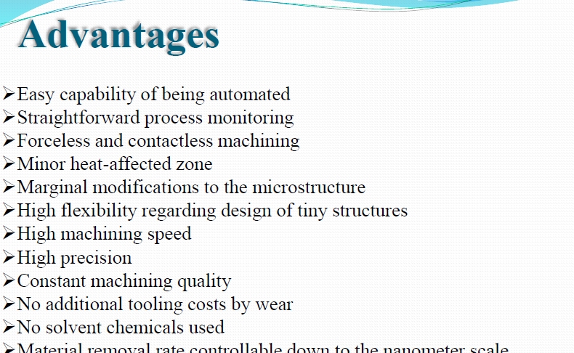
Laser Micromachining

Slide 24
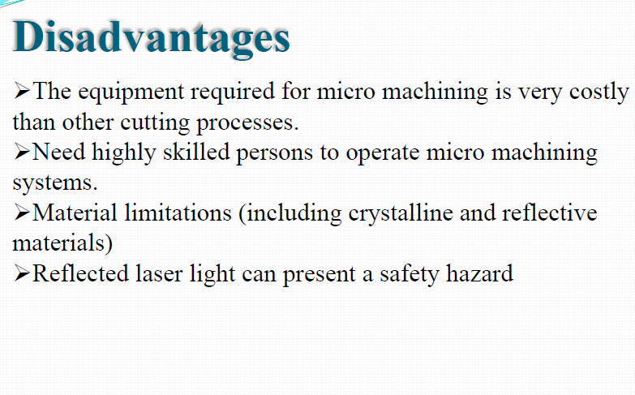
Laser Micromachining

Slide 25
HOM WORK
Explain the relation between the bend angle and sheet thickness

